Slide 1
ACCESS-CM2 model results.
Sullivan, Arnold; Bi, Daohua; Bodman, Roger; Dix, Martin; Dobrohotoff Peter; O’Farrell Siobhan; Law, Rachel; Mackallah, Chloe; Marsland, Simon; Rashid, Harun; Srbinovsky, Jhan;

Slide 2
Outlines
SST and SST Bias
ACC/AMOC
Intraseasonal Oscillation-MJO

Slide 3
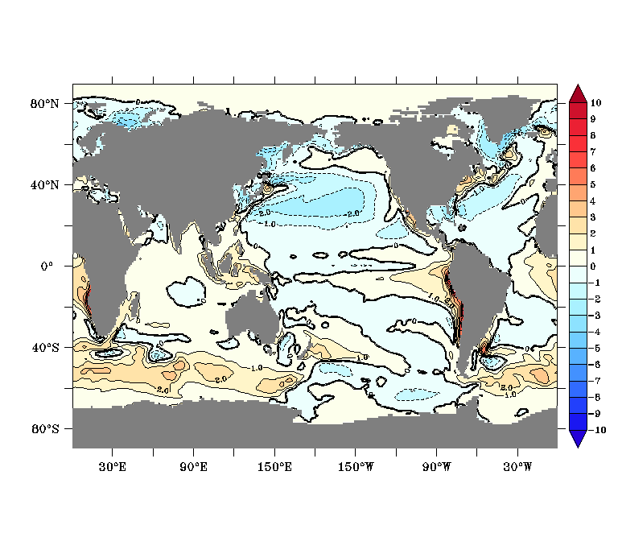
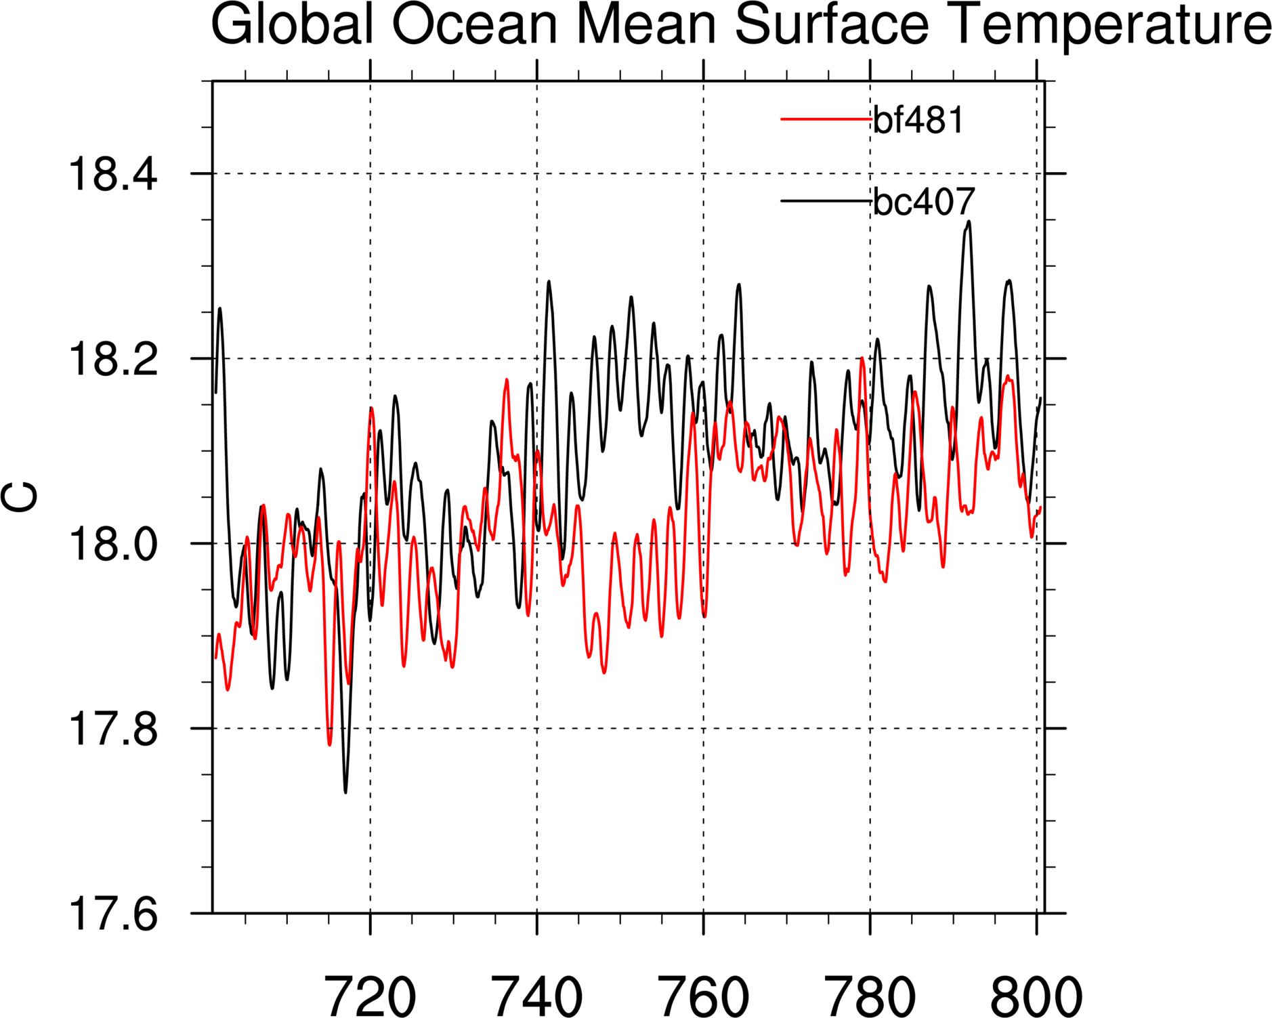
Global Sea Surface Temperature
SST Bias (800-829)
SST
CM2c
CM2j

Slide 4
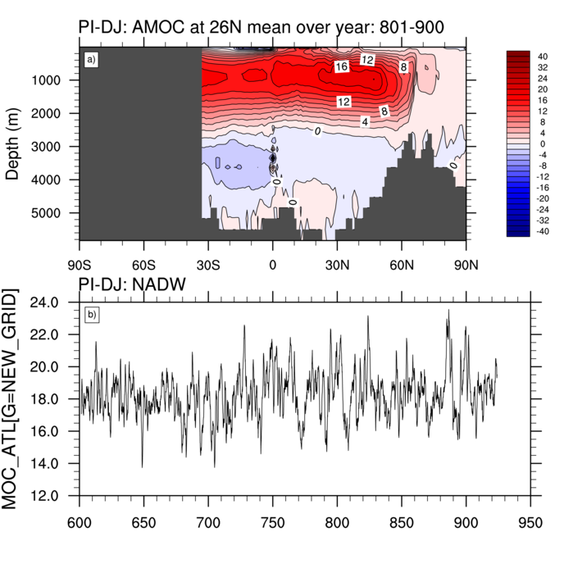
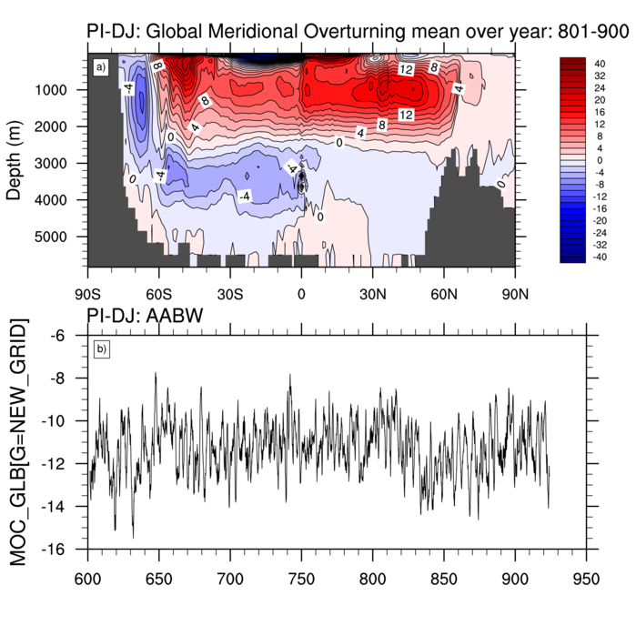
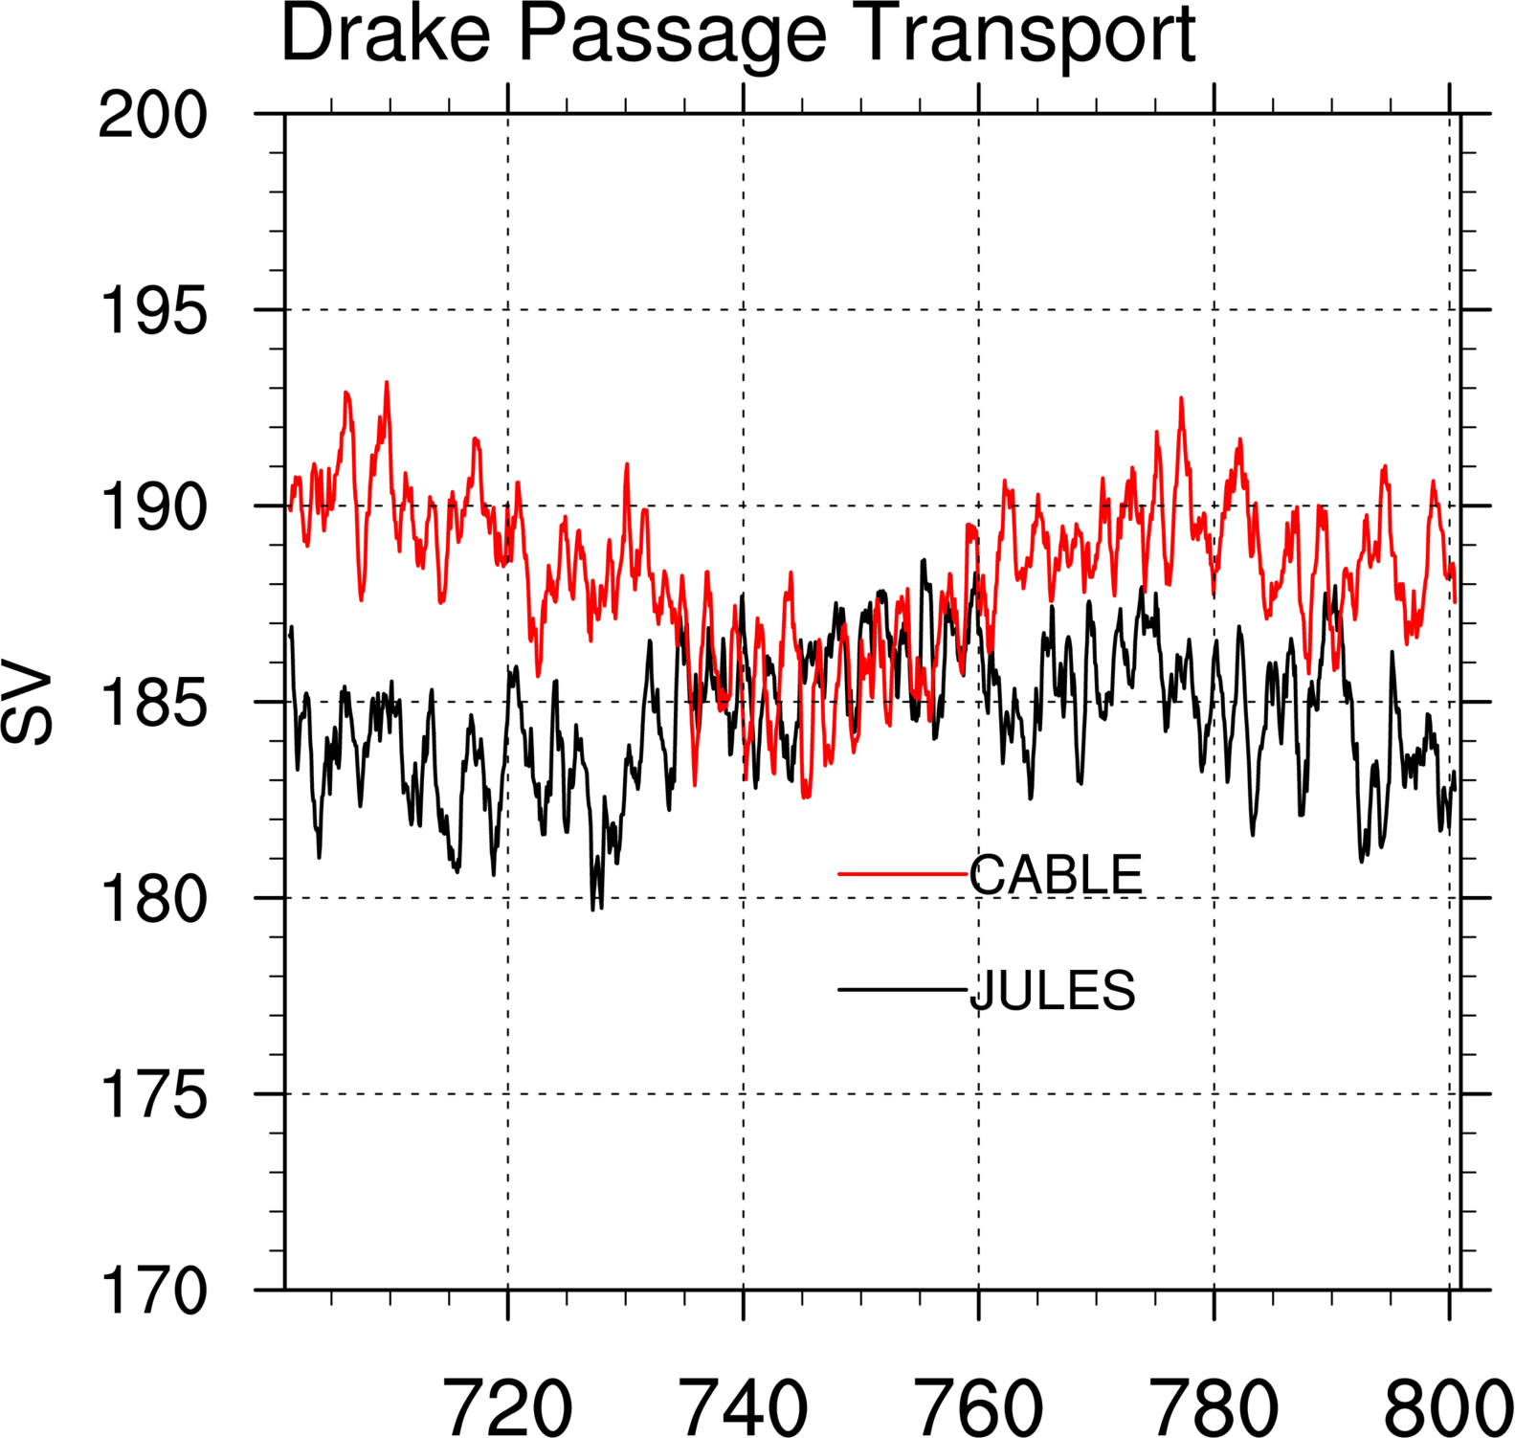
JULES: ACC/MOC
AMOC @ 26N
AABW
Yr 801-900
18sv
11sv

Slide 5
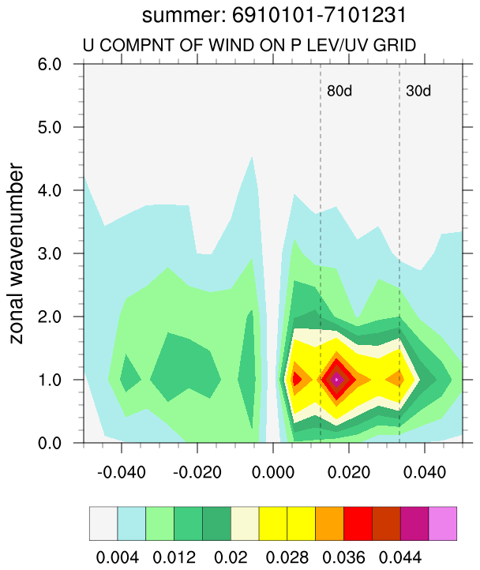
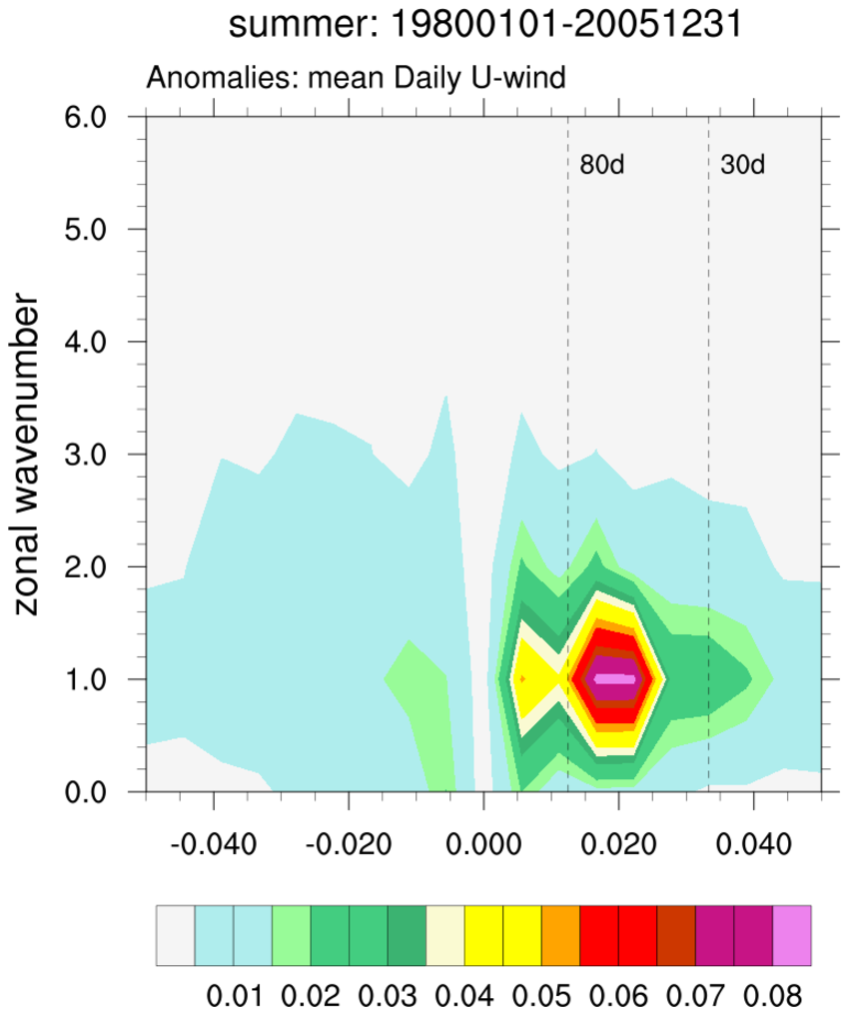
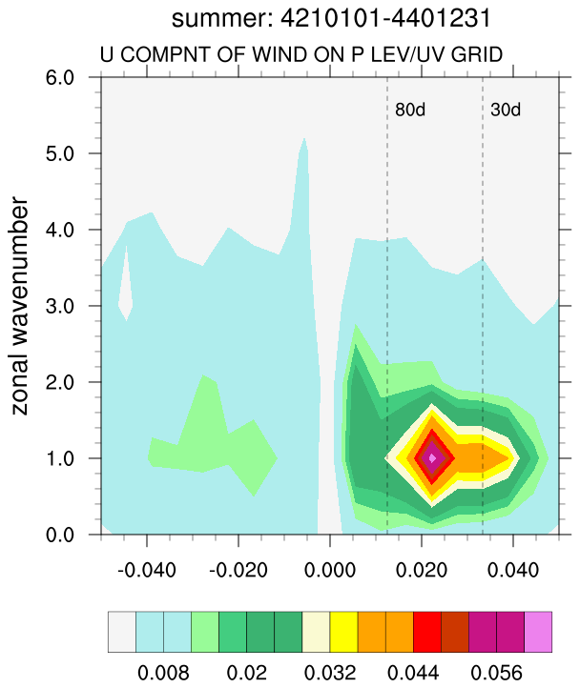
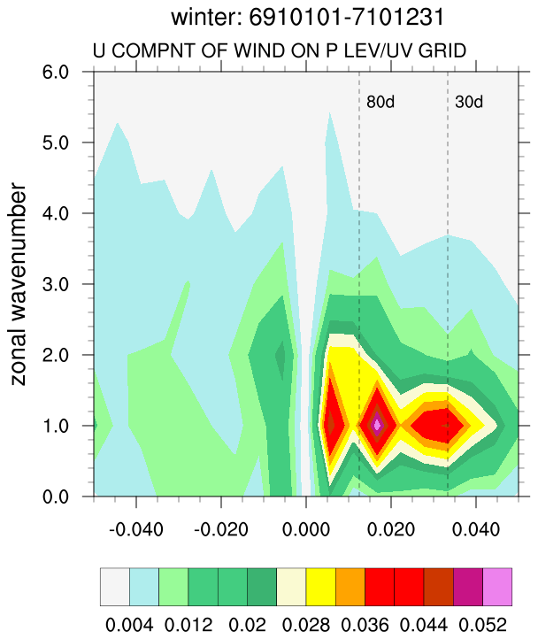
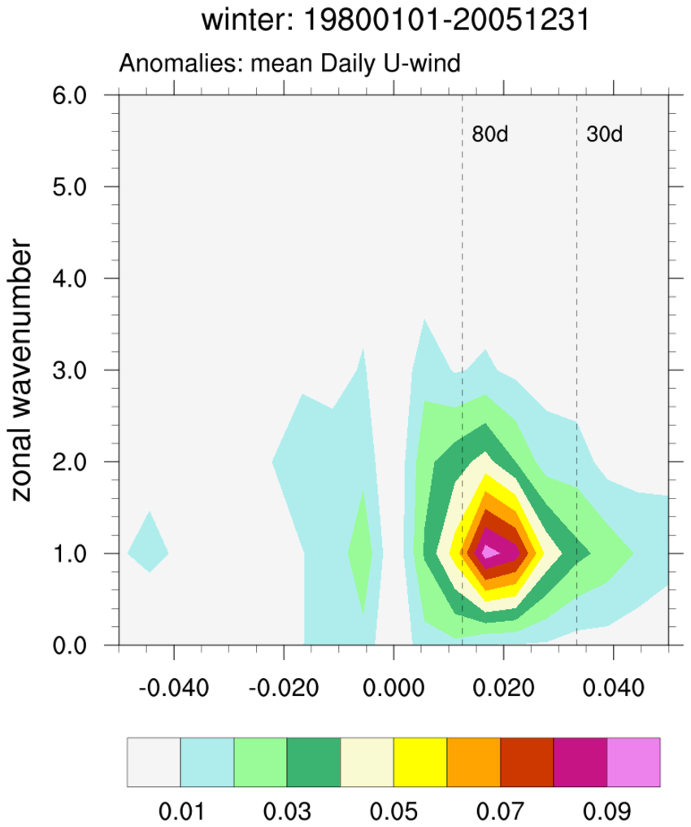
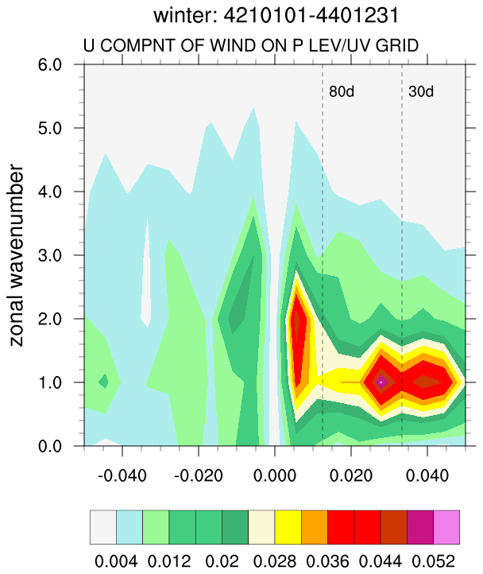
Cross-spectra: coherence-squared and phase relationships in wavenumber-frequency space
JULES
Obs.
CABLE
6
5
4
3
2
1
0
Summer
Wavenumber
6
5
4
3
2
1
0
Winter

Slide 6
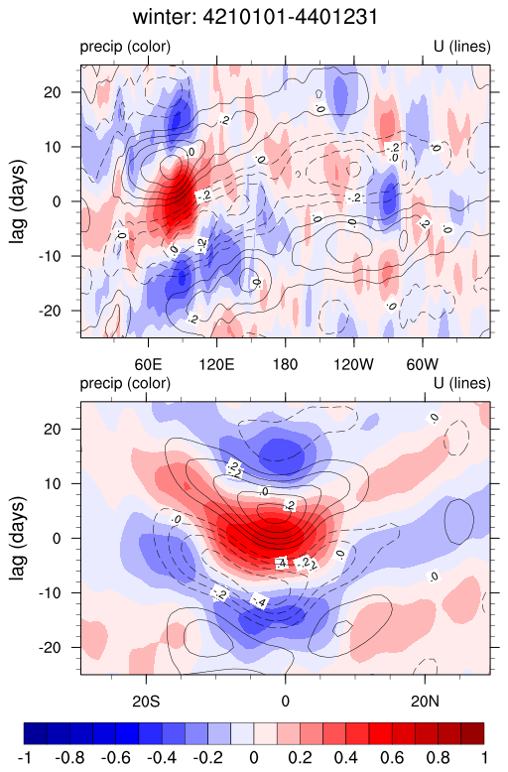
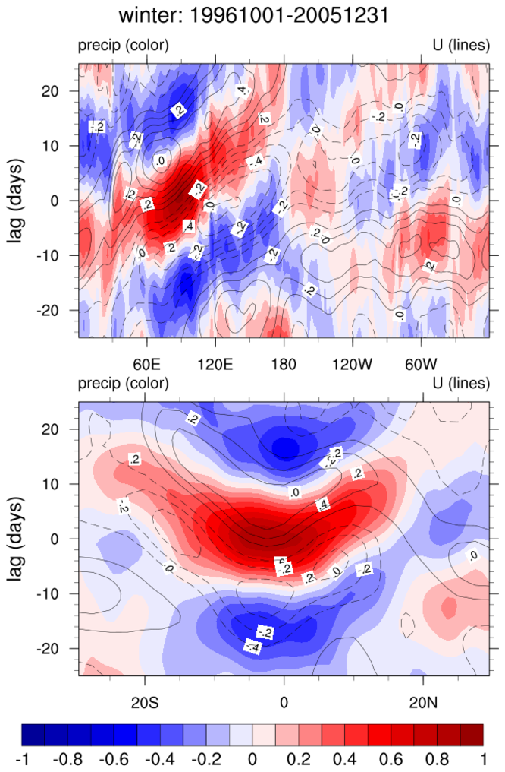
Winter: lag-cross-correlations
CABLE
Observation
Lead-lag (days)
Lead-lag (days)

